Slide 1

.NET Conf 2019 updates for Mobile Developers
ALEJANDRO RUIZ
Microsoft MVP
@alejandroruizva

Slide 2
.NET Conf 2019 Announcements
.NET Core 3.0
ASP.NET Core 3.0
Entity Framework Core 3.0
Visual Studio 2019 16.3
Visual Studio 2019 for Mac 8.3

Slide 3
Xamarin Announcements
XAML Hot Reload for Xamarin.Forms (Stable)
Xamarin Hot Restart (Preview)
iOS 13 Support
Android 10 Support
Xamarin.Forms 4.3

Slide 4
XAML Hot Reload for Xamarin.Forms 🔥🔃
XAML Hot Reload for Xamarin.Forms enables you to make changes to your XAML UI. Also see them reflected live, without requiring another compile and deploy.
Your application is compiled using XAML Hot Reload. Which means it works with all libraries and third-party controls. Whether you are building an iOS or Android app or iterating on an emulator, simulator, or physical device, XAML Hot Reload plugs into your existing workflow. This enables you to rapidly iterate over your user interface.

Slide 5
Demo

Slide 6
Xamarin Hot Restart
XAML Hot Reload for Xamarin.Forms enables you to rapidly iterate on your XAML UIs at runtime without having to build and deploy. However, what about other types of changes? Such as C# code edits, adding resources, or multi-file edits?
To enable rapid iteration for these scenarios, Xamarin is introducing Xamarin Hot Restart. Which applies changes made to your app, including multi-file code edits, resources, and references. Rather than having to perform a full incremental build and deploy again when making larger edits to an app, Press the restart button. This will push the new assemblies directly into the existing app bundle.

Slide 7
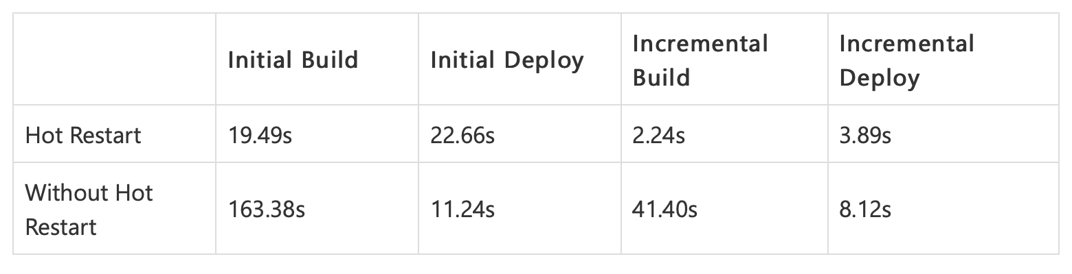
Impact
See the impact of the Xamarin Hot Restart can have on your inner development loop. Check out the improvements seen when using Xamarin Hot Restart on the SmartHotel360 app:

Slide 8
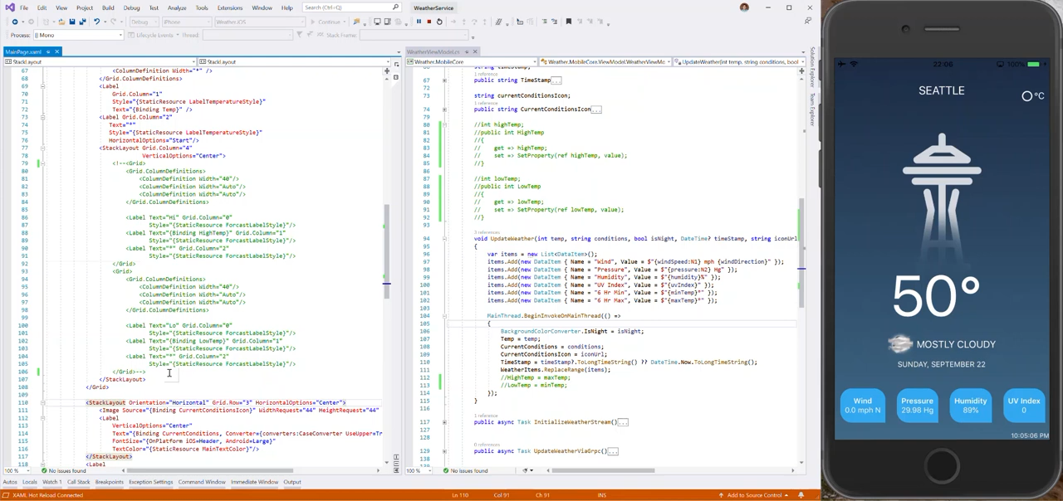

Slide 9
Sign up for Preview
http://bit.ly/HotRestartPreview

Slide 10


iOS 13 Support
iPadOS
iPadOS enables greater use of the Apple Pencil using PencilKit with new gestures. It allows the use of multiple windows and drag-and-drop various content between apps. iPadOS can also allow apps to provide system-wide fonts.
Dark Mode
a system-wide option for light and dark themes. Now, users can switch to Dark Mode to use darkened iOS color schemes.
Sign in with Apple
enables users to set up a privacy-friendly, secure account.

Slide 11

Android 10 Support
Dark Theme
Ensure a consistent experience for users who enable system-wide dark theme by adding a Dark Theme or enabling Force Dark
Support gestural navigation
gestural navigation in your app by going edge-to-edge and making sure your custom gestures are complementary to the system navigation gestures
Optimize for foldables
Deliver seamless, edge-to-edge experiences on today’s innovative devices by optimizing for foldables

Slide 12
Xamarin.Forms 4.3
CollectionView
RefreshView
SourceLink Support
Display HTML on Labels
CarouselView
Preview Shell Support in UWP
And More: http://bit.ly/XamarinForms43

Slide 13
Demo

Slide 14
Questions?
Alejandro Ruiz
Microsoft MVP: Developer Technologies
.NET Conf 2019 updates for Mobile Developers
DEMO: https://github.com/AlejandroRuiz/DotNetConf2019
alejandro@alejandroruizvarela.com
https://alejandroruizvarela.blogspot.mx
@alejandroruizva

